Slide 1

Learning intentions: Today we are learning about beliefs about God and focusing on God the creator.
Success criteria:
By the end of the lesson I will be able to:
. Be clear about the Omni’s.
. Understand the story of creation according to Judaism.
. Know the order of that creation.

Slide 2
Judaism
Beliefs
• beliefs about God
• nature of human beings: yetzer tov; yetzer harah; free will; suffering
• beliefs about Covenant
• judgement; the Messiah; the Messianic Age; Olam Ha’ba
Practices
• living according to the Commandments
• Rosh Hashanah; Yom Kippur
• worship: Shabbat; synagogue

Slide 3

Starter task
On the post it note in front of you answer the following questions.
The Jewish word to describe the idea of an all powerful God:
What does the word monotheistic mean?
Omniscient means:
A God that is good and loving is described as:

Slide 4
Starter task
On the post it note in front of you answer the following questions.
The Jewish word to describe the idea of an all powerful God: Omnipotent
What does the word monotheistic mean? A belief in one God.
Omniscient means: All knowing
A God that is good and loving is described as: OmniBenevolent

Slide 5
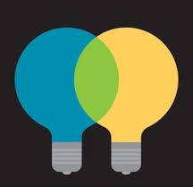
We have learnt that God has many different characteristics.
He is one as well as all the Omnis, and the characteristics on the sheet.
These reveal two very different and distinct ideas about God which are both considered equally important.

Slide 6

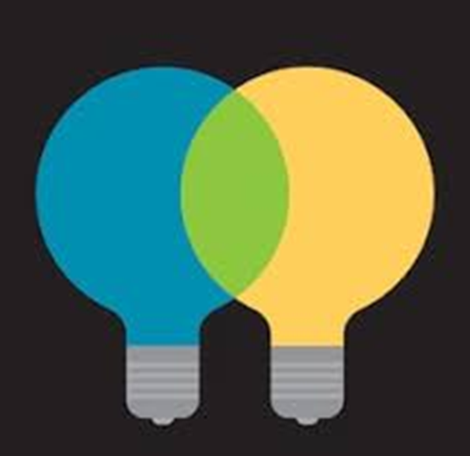
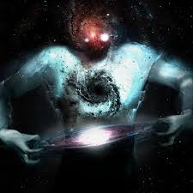
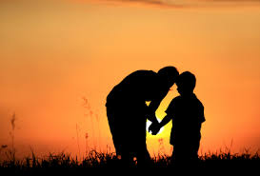
Two distinct ideas about God can be seen:
1. God is an all-powerful being who is quite beyond human ability to understand or imagine.
2. God is right here with us, caring about each individual as a parent does their child.
Judaism seeks to combine these two ideas.

Slide 7


God is an all-powerful being who is quite beyond human ability to understand or imagine. POWER
God is right here with us, caring about each individual as a parent does their child. PRESENCE
Look through the list again and highlight the ideas according to whether they show Gods power or his presence.
Make a key to explain your work
Power Presence

Slide 8
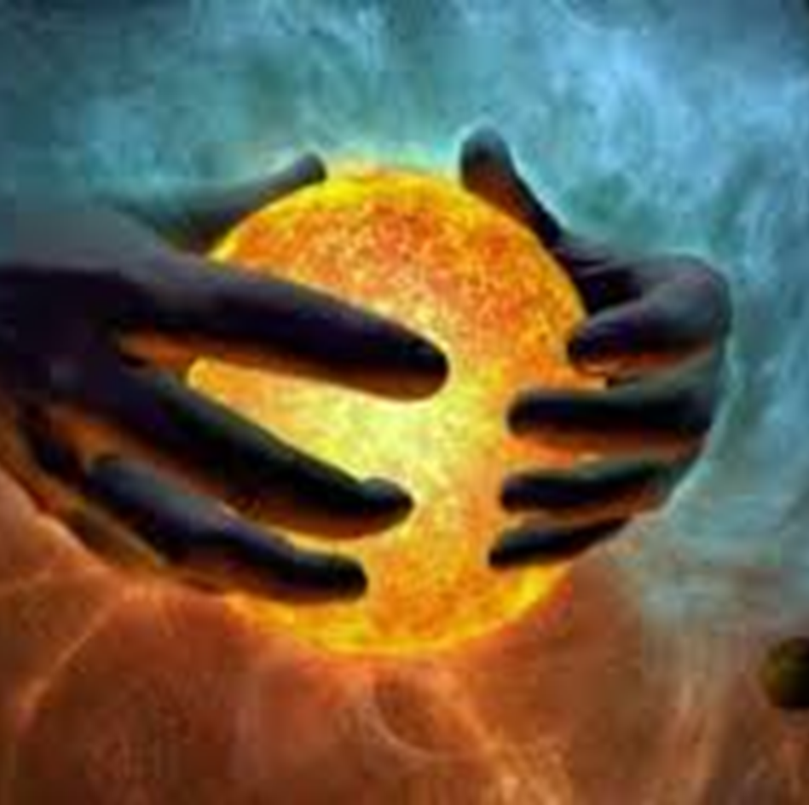
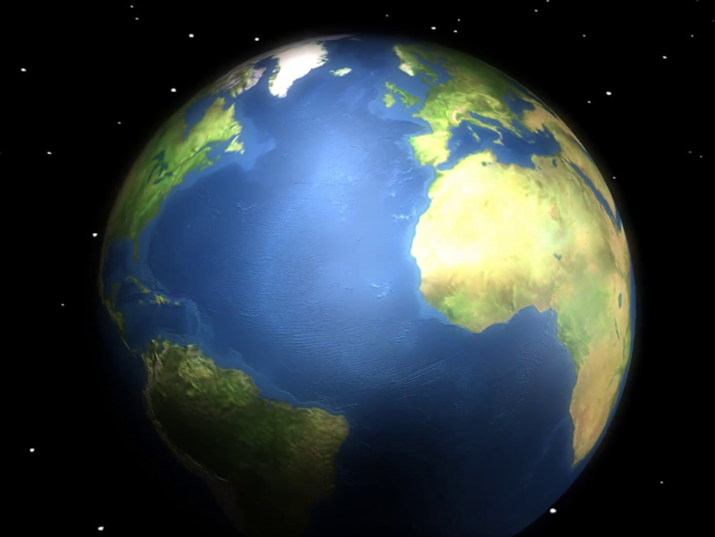
Another key aspect of God’s nature if that he is the creator. So we are going to be learning about the Jewish view on how the world began.
But what do you think?
How did the world begin?

Slide 9

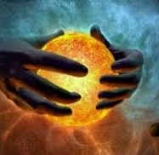
The Jewish perspective: “Creatio ex nihilo” Latin meaning: Creation out of nothing.

Slide 10
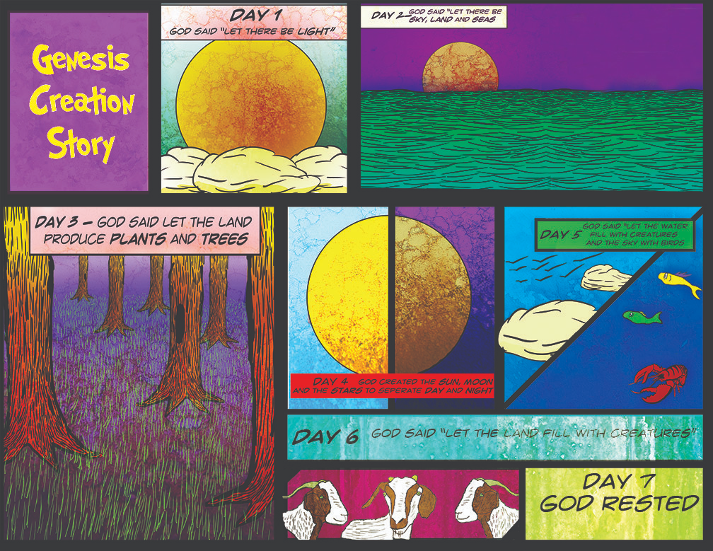
The creation story is the found in the first book of the Torah: Genesis.
Lets read it together.
https://www.youtube.com/watch?v=yZ1Fd_SPC18&t=113s

Slide 11
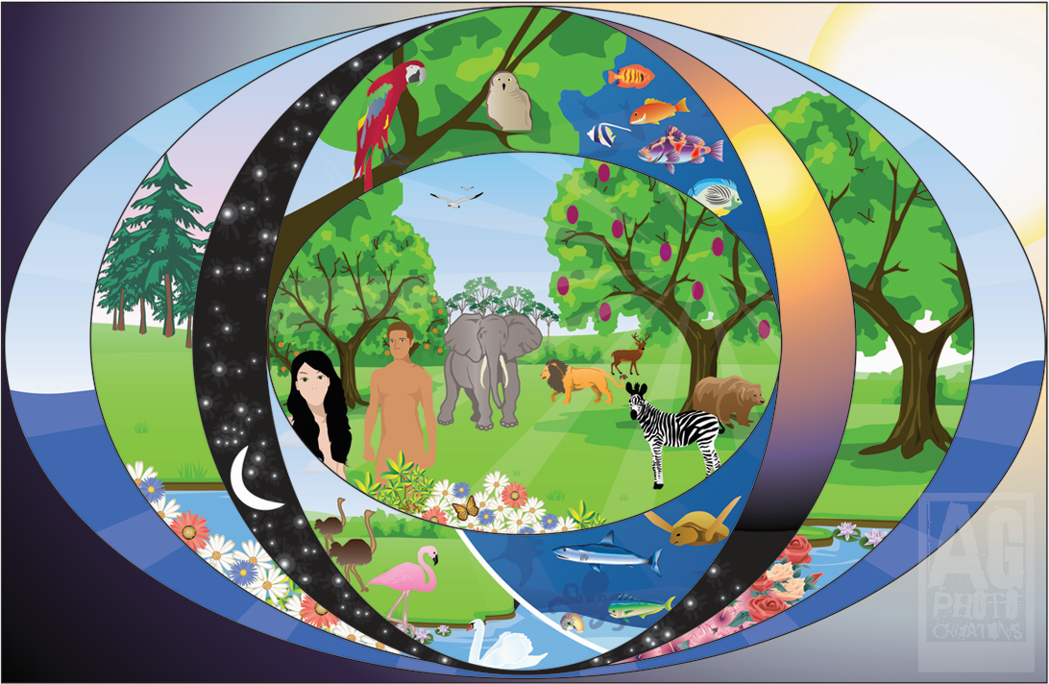
Task:
Read through the creation story again and take note of what happens on each day.

Slide 12
The Creation Story
God created the Earth and divided the light from darkness.
God separated the sky and the oceans.
God created the land and plants.
God created the sun and the stars.
God created sea creatures and birds.
God created land animals and humans.
God rested.
What do you notice about the order?

Slide 13

Google classroom code:
bdt6wuc

Slide 14
Judaism
Beliefs
• beliefs about God
• nature of human beings: yetzer tov; yetzer harah; free will; suffering
• beliefs about Covenant
• judgement; the Messiah; the Messianic Age; Olam Ha’ba
Practices
• living according to the Commandments
• Rosh Hashanah; Yom Kippur
• worship: Shabbat; synagogue

Slide 15

Task: On A3 or A4 paper create a story board explaining the creation story.
Genesis 1 v.1- 2 v.3

Slide 16
Lets hear from a few people about these ideas.
2. Jews take this as evidence that God gave humans dominion over his creation, meaning that humans have a special responsibility to lead creation and look after the earth.
1. The story opens with the creation narrative. We discover the universe as a place of order and goodness, the result of a single creative will.
3. We may be, like the first human, “dust of the earth,” but there is within us the “breath of God.” We are shaped by our environment, but we can also shape our environment as well. We are created, but also creative. To a degree shared by no other life form known to us, we can choose how to act and how to react.
4. Some Jews, read the creation story in Genesis literally, which means that they believe that God created the world and everything exactly as the story describes.
Other Jews see the account in Genesis as an allegory. This means that they do not believe that the world was created exactly as Genesis describes, but instead take important meaning from the story that God created the world and gave human beings a special role within it.

Slide 17
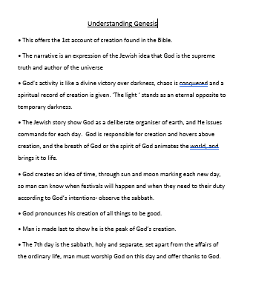
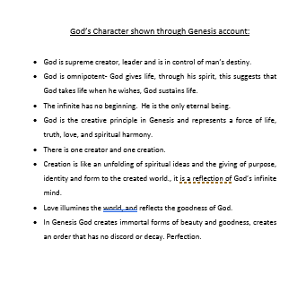
“Understanding Genesis” the other “God’s character shown through the Genesis account.”

Slide 18
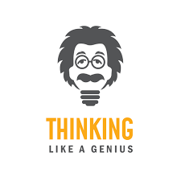
Does God as the creator make him responsible for everything that happens in creation?

Slide 19
Task: Question time
Answer the following questions
What does it mean to say that God is omnipotent? Is there anything that he cannot do? (2)
Omnipresent means God is everywhere. How does this fit into the idea of creation? (2)
What does it mean to say that God is Omniscient? (2)
Explain one advantage and one disadvantage of believing in a God that has these characteristics? (4)

